Slide 1
Overview
Current Understanding:
GameCo’s current understanding is that sales for the various geographic regions have stayed the same over time.
Scope :
Market Analyses of the 3 regions (North America, Europe and Japan) for the period 2006-2016.
Revise GameCo’s understanding and make recommendations.

Slide 2
Global Sales trend: 1983-2016
North America is the foremost with highest sales from 1983-2015
European market (EU) steadily on the rise.
The Japan Market (JP), is behind North America and Europe due to smaller market size.

Slide 3
Top Genres for the 3 regions for 2006-2016
North America and Europe have the top 3 genres as Action, Sports and Shooter.
Japan has top 3 as Role Playing, Action and Misc.
All 3 have Action as one of the top 3 genres

Slide 4
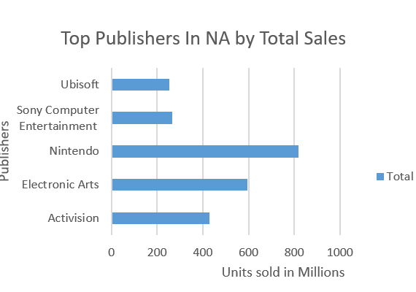
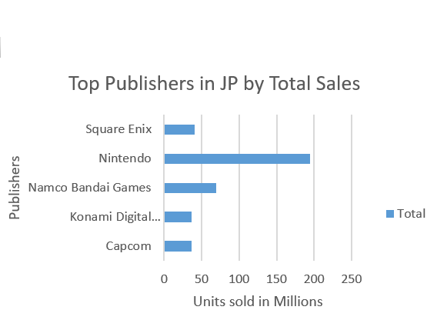
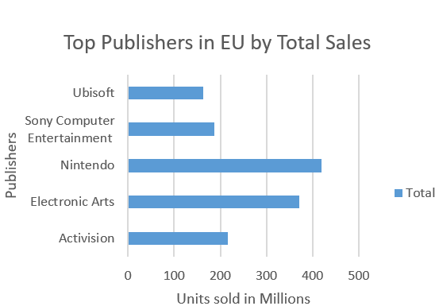
Top Publishers in the 3 regions from 2006-2016
North America and Europe have the top3 publishers common as Nintendo, Electronic Arts and Activision.
Japan has only Nintendo in the top 5 with the rest being Namco Bandai and Konami Digital

Slide 5
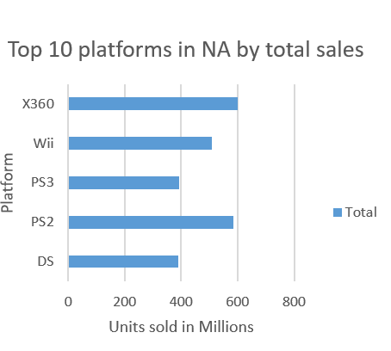
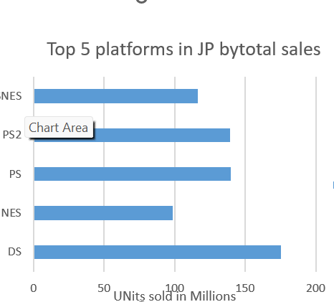
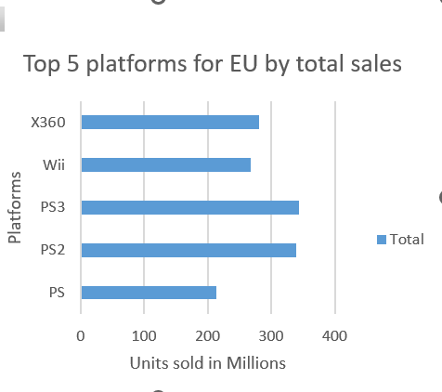
Top 5 Platforms in regions for 2006-2016
The top platforms in the region are X360, DS, PS2 and Wii.

Slide 6
Revised Understanding
Key points noted:
While North American market has the highest sales, despite a declining trend in the last decade.
European market shows steady sales growth with 10% to 37%.
The Japan Market, showing a slight positive upward trend since 2016 with 37% market share .
North America and Europe have a few things common like
Top genre Action, Shooter, Sports games
Top publishers : Nintendo, Electronic Arts, Activision
Popular platforms as X360,PS, DS
Japan has top genre as Role playing and Nintendo, N as the top publisher
Recommended understanding
Based on the above data the sales in the 3 geographic areas have changed and North America and Europe must be considered as having equal potential with Japan having growth potential.

Slide 7
Recommendations
Budget Allocation
GameCo should maintain the support for the North America market as despite decline it is still one of the biggest market.
European Focus
As Europe has shown steady increase in market share surpassing NA in 2016,focus must be given to increase the market share by tailoring marketing initiatives for local needs.
Optimizing Budget
Optimize the marketing budget by efficient spending in North American and reallocating funds to high-growth opportunities in Europe.
Japan being smaller market, the marketing budget should be focused on Role-playing, Action, and Miscellaneous games.
In North America and Europe should focus on the top performing genres; Action, Sports, and Shooter games.

